Slide 1
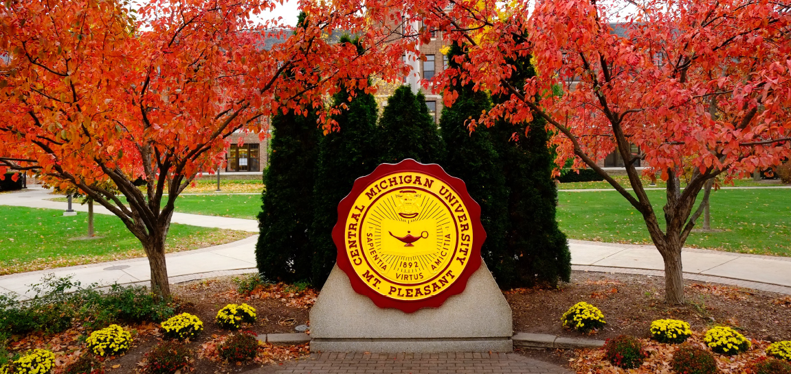
Title of Poster Here:
Use Franklin Gothic Demi Condensed
Presenter Names • Department • University
Use CMU Approved Fonts
All poster body text should be set in Franklin Gothic Book if available. The Office of Curriculum & Instructional Support provides a number of ways to help you create professional quality research posters. Our templates on this page provide a good starting point as you begin building your poster. Our posters come in a variety of sizes, and use approved CMU colors and standard system fonts. If this template does not suit your needs, please contact us at cis@cmich.edu, or use our DesignPro ticketing system. We would be happy to customize a template for your purposes.
If this template does not suit your needs, please contact CIS DesignPro. We would be happy to customize a template for your purposes. Tip for Paragraph Spacing To eliminate the default big space between paragraphs (such as in the case of headline and first paragraph above, use the “shift + return/enter” key command to enter a line break or soft return. The Office of Curriculum & Instructional Support provides a number of ways to help you create professional quality research posters. Our templates on this page provide a good starting point as you begin building your poster.
Subheading 50 pt Bold All poster body text should be set in Franklin Gothic Book if available. The Office of Curriculum & Instructional Support provides a number of ways to help you create professional quality research posters. Our templates on this page provide a good starting point as you begin building your poster.
Use CMU Approved Fonts
When using CMU Maroon or Gold, please use the correct mixes: CMU Maroon Hex code: #6a0032 CMU Gold Hex code: #ffc82e
Contact the Author:
Please contact AUTHOR NAME, if you have any questions: Address line 1 Add Line 2 City, State, Zip Phone E-mail
Changing the Fonts
Subheading 50 pt Bold BODY TEXT = Should also be Franklin Gothic Book. Feel free to copy/paste headings and design elements. Theme Colors When creating tables, graphics, or SmartArt, use the Theme Colors across the top of of the color menu. Stick to mainly CMU Maroon & Gold (in the theme menu already), but use various teal, light blue, and red accents (also in the theme menu already) sparingly.

